Slide 1
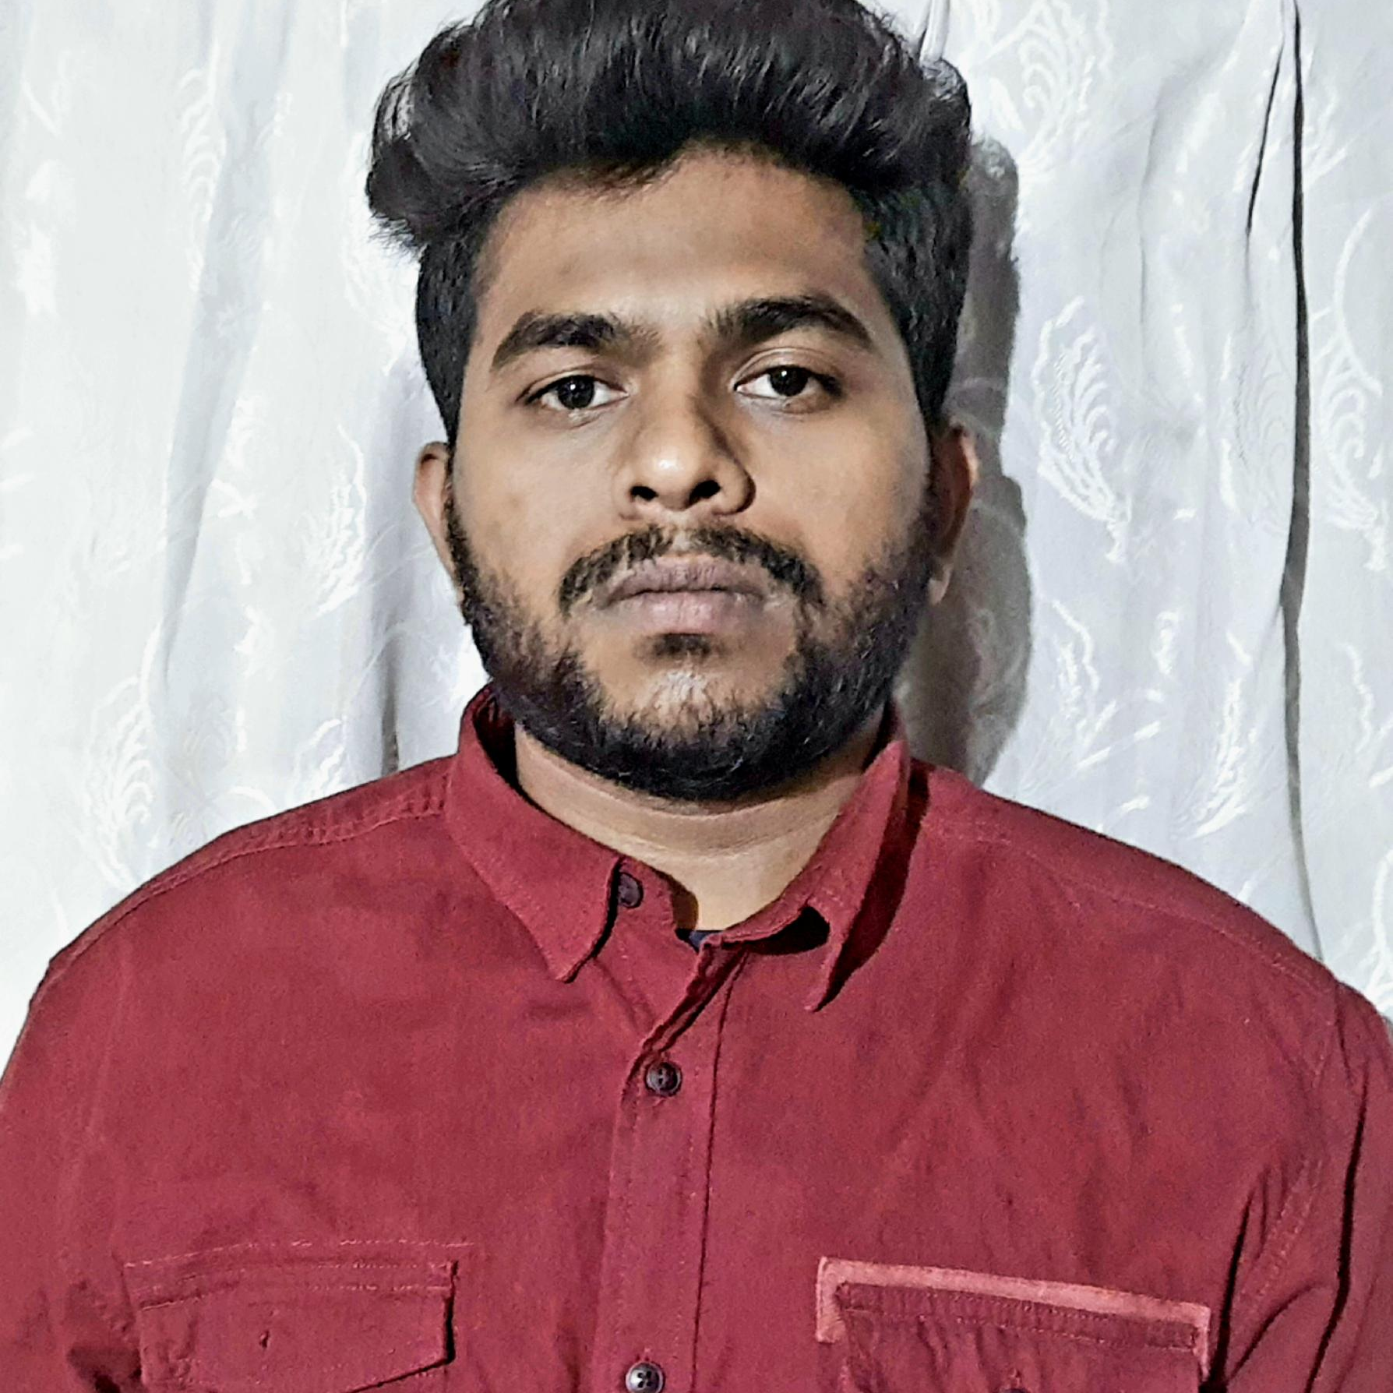
Modumpelly Santhosh
Bachelor of Technology in
Computer Science And Engineering:2017-2021
Analyst/Software Engineer
•Core Java
•Spring Boot
•Spring MVC
•MongoDB
•React JS
Skills
Bangalore
Santhosh.modumpelly@capgemini.com
+91 8179579009
A4
Backend
•Spring Boot/Spring Security
•MongoDB
•REST-API
Database
•No SQL database –MongoDB
Proficient in Java and OOPs concepts.
.Ready to learn new technologies and implement them to further improve my knowledge.
•Eager to work in a team of dedicated people and serve a key role in the enhancement and development of the project.
•Has working knowledge on ReactJS and Microservices Development (CRUD operations) using Spring framework on an intermediate level.
•Also have knowledge on working with database management.
Deals And Coupon Application
Working on End to End case study of Deals and Coupon Application along with authentication, Swagger and React used for user interface.
Spring Boot and React for web developers in Degreed Platform
Completed this course with optimal Knowledge of MVC ,Web API , RESTful services , Components.
Online Deals and Coupon Application
Developed Online Deals and Coupon app using Frontend react and Backend Spring Boot Web API with MongoDB as Database .
Web Technologies
•HTML5
•CSS3
•JavaScript/TypeScript
Additional Details
•Good Communication Skills
•Team Player

